Slide 1
Transcriptomics:
RNA-seq analysis: an overview
Ricardo Ramirez-Gonzalez (JIC)
Rachel Rusholme pilcher, PAUL BAILEY

Slide 2
An introduction to RNA-seq
Exercises: Exploring the dataset
Mapping reads and quantifying gene expression
Exercises: Mapping and quantifying the reads with HISAT2 and kallisto
Differential expression analysis
Exercises: Exploring the normalized data and calling DE with Ballgown and sleuth

Slide 3


Slide 4
Evolution of transcriptomics technologies
1
Northern Blot • Single Genes
RT-PCR • Multiple genes
Microarrays • Whole Genomes
(NGS) RNA-seq • Populations of genomes

Slide 5
What is RNA-seq?
1
RNA-seq is the high throughput sequencing of cDNA using NGS technologies
RNA-seq works by sequencing RNA molecules and profiling the expression of a particular gene by counting the number of time its transcripts have been sequenced.
The summarized RNA-seq data is known as count data

Slide 6
Microarrays vs. RNA-seq
Microarray
Less cost
Probes based on prior knowledge
Cannot detect novel fusions or transcripts
Standardized data analysis
High throughput
RNA-seq
Comprehensive view of transcriptome
Increased dynamic range and sensitivity
Reveal sequence variations (e.g. SNPs) and splice variants
Can detect absolute abundance
Data analysis is actively being developed
Detect novel transcripts and isoforms (inform gene models)
Map exon/intron boundaries, splice junctions
Analyze alternative splicing

Slide 7
Different types of RNA-seq
mRNA Sequencing
Measures gene and transcript abundance and detects both known and novel features in the coding transcriptome.
Small RNA Sequencing
Isolates and sequences small RNA species, such as microRNA, to understand the role of noncoding RNA in gene silencing and posttranscriptional regulation of gene expression.
Single-Cell RNA-Seq
Uses deep RNA-Seq to examine the signals and behaviour of a cell in the context of its surrounding environment. This method is advantageous for biologists studying processes such as differentiation, proliferation, and tumorigenesis.
RNA Exome Capture Sequencing
Detects both known and novel features of the RNA exome using sequence-specific capture of RNA coding regions.
Ribosome Profiling
Deeply sequences ribosome-protected mRNA fragments to gain a complete view of the ribosomes active in a cell at a specific time point, and predict protein abundance.

Slide 8
Limitations of RNA-seq
Non-uniformity coverage of the genome due to experimental factors
Transcript-length bias
Read mapping uncertainty caused by sequencing error rates, repetitive elements, incomplete genome sequence, etc
Downstream bioinformatics algorithm/software evolving
Costs more than microarray experiments

Slide 9
RNA-seq

Slide 10
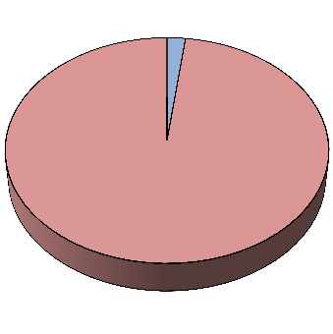
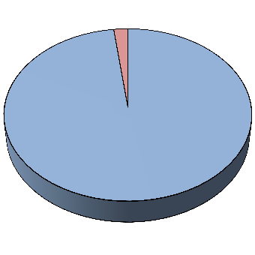
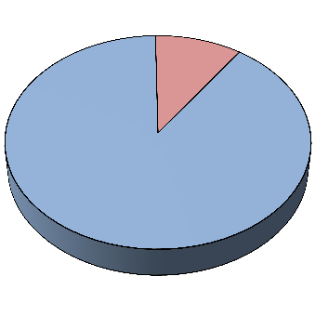
Creating mRNA-seq libraries
PolyA Selection
Oligo-dT, often using magnetic beads
Isolates mRNA very efficiently unless total RNA is very dilute
Can’t be used to sequence non-polyA RNA
rRNA Depletion
RiboZero, RiboMinus
Non-polyA RNAs preserved (non-coding, bacterial RNA, etc.)
Can be less effective at removing all rRNA
mRNA rRNA
rRNA
rRNA
mRNA
mRNA
Total RNA
sample
After PolyA isolation
After rRNA depletion

Slide 11
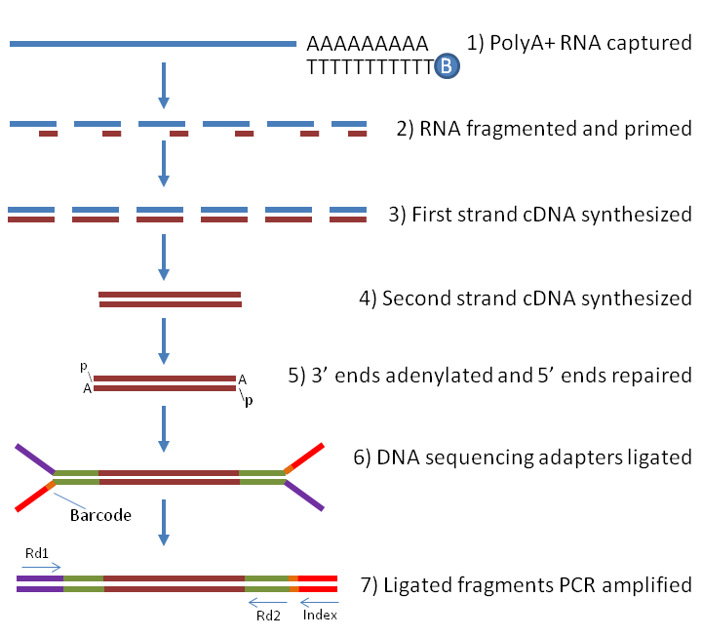
Creating mRNA-seq libraries

Slide 12
Creating mRNA-seq libraries
Adapter
~60 bases
cDNA
100-800 bases
=Insert Size
Adapter
~60 bases
The “insert” is the cDNA (or RNA) ligated between the adapters. Typical insert size is 160-200 bases, but can be larger.
Insert size distribution depends on library prep method.
Overlapping paired-end reads Gapped paired-end reads
Single-end read
0 20 40 60 80 100 120 140 160 180 200

Slide 13
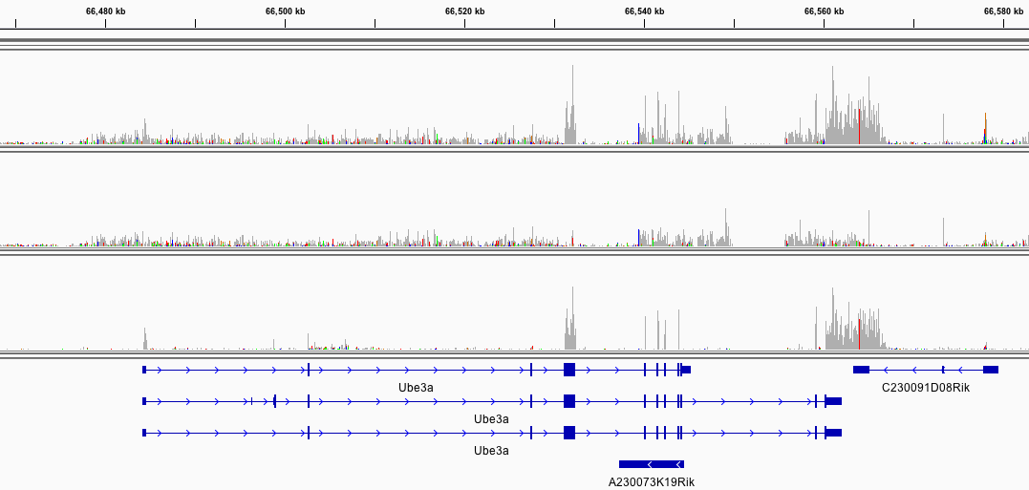
Strand-specific (directional) mRNA-seq
Standard library (non-directional)
Antisense non-coding RNA
Sense transcripts
Now the default for Illumina TruSeq kits
Preserves orientation of RNA after reverse transcription to cDNA
Inform alignments to genome
Determine which genomic DNA strand is transcribed
Identify anti-sense transcription (e.g., lncRNAs)
Quantify expression levels more precisely
Demarcate coding sequences in microbes with overlapping genes
Very useful in transcriptome assemblies
Allows precise construction of sense and anti-sense transcripts

Slide 14
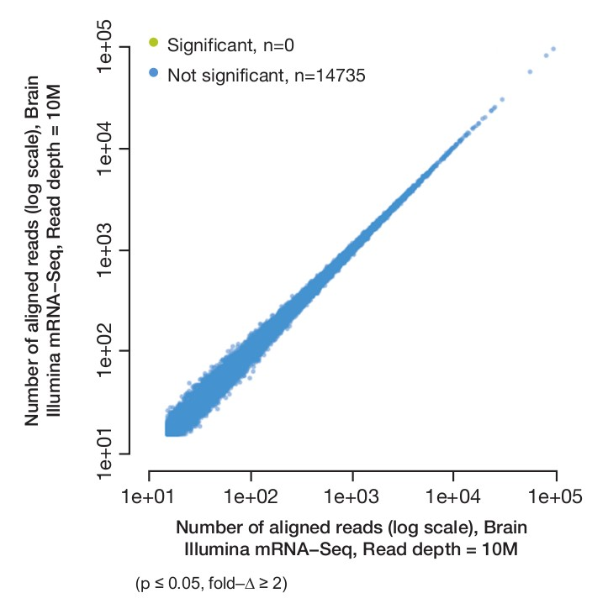
Technical replicates
The same cDNA pool is sequenced several times: technical replicates.
Account for variation in preparation
Cost can be prohibitive
Better to do more biological replicates
Barcoding/pooling samples across multiple lanes
Recommended to even out lane
effects
Allow data processing even if one lane fails

Slide 15
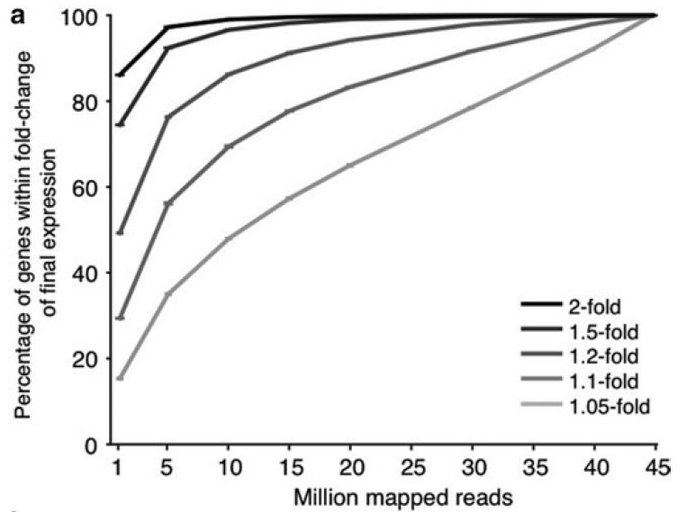
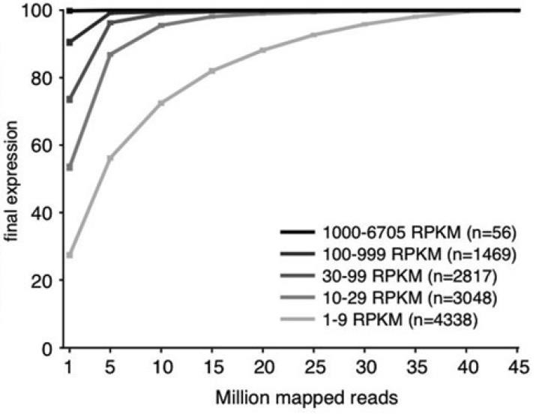
Sequencing depth
Differential gene expression, reads/sample
Eukaryotes: 30+ million recommended
Bacteria: 10+ million recommended
More sequence is needed to detect rare transcripts
Measures of Robustness of Expression Levels vs. Sequencing Depth (hg19)
Ramskold, et al., 2012

Slide 16
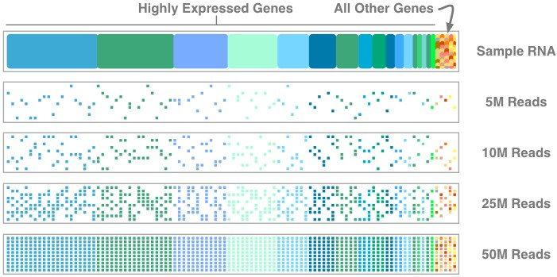
Adequate read depth is needed to detect low-expression transcripts
https://www.lab7.io/ngs-101-biology-is-a-big-data-problem/

Slide 17
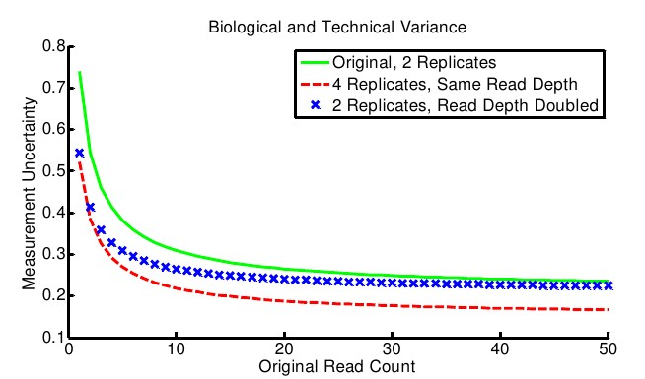
Increase sequencing depth, or replicates?
Variance will be lower with more reads: but sequencing another biological replicate is preferred over sequencing deeper, or technical reps.
Busby et al. Scotty: a web tool for designing RNA-Seq experiments to measure differential gene expression. Doi: 10.1093/bioinformatics/btt015
68 of 74

Slide 18
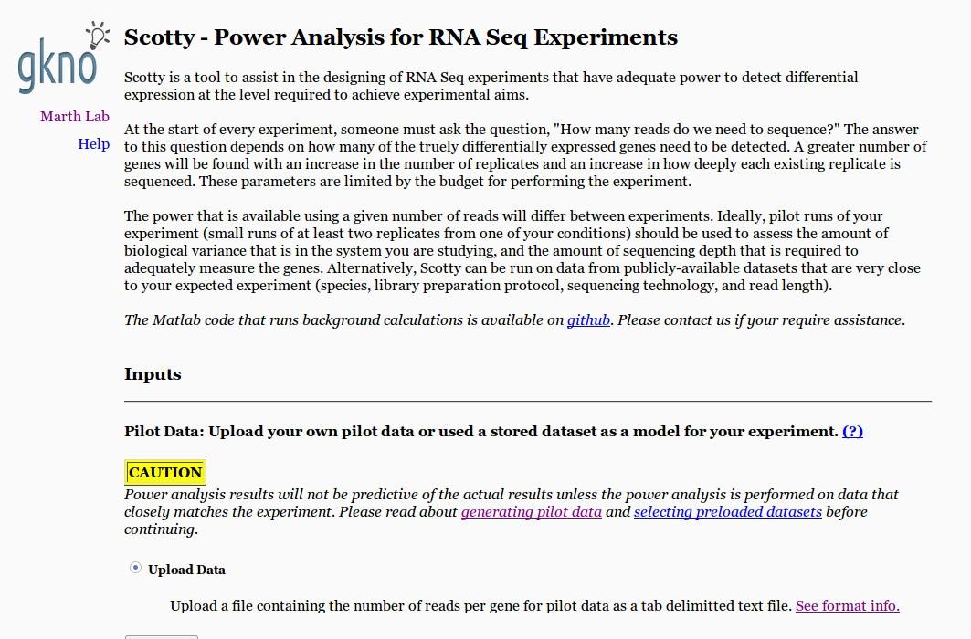

Slide 19
mRNA-seq analysis workflow
raw
data
quality
control
adaptor removal
trimming
reference genome + GTF
reference transcriptome + GTF
reference free assembly
aligning
reads
SAM/BAM files
transcript discovery &
quantification
normalization
visualization
differential expression
testing

Slide 20
Common Data Formats
FASTA format:
>61DFRAAXX100204:1:100:10494:3070/1
AAACAACAGGGCACATTGTCACTCTTGTATTTGAAAAACACTTTCCGGCCAT
FASTQ format:
@61DFRAAXX100204:1:100:10494:3070/1
AAACAACAGGGCACATTGTCACTCTTGTATTTGAAAAACACTTTCCGGCCAT
+
ACCCCCCCCCCCCCCCCCCCCCCCCCCCCCBC?CCCCCCCCC@@CACCCCCA
Read
Quality values

Slide 21
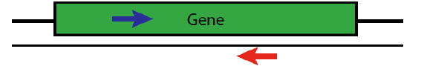
Paired-end sequences
Two FastQ files, read name indicates left (/1) or right (/2) read of paired-end
@61DFRAAXX100204:1:100:10494:3070/1
AAACAACAGGGCACATTGTCACTCTTGTATTTGAAAAACACTTTCCGGCCAT
+
ACCCCCCCCCCCCCCCCCCCCCCCCCCCCCBC?CCCCCCCCC@@CACCCCCA
@61DFRAAXX100204:1:100:10494:3070/2
CTCAAATGGTTAATTCTCAGGCTGCAAATATTCGTTCAGGATGGAAGAACA
+
C<CCCCCCCACCCCCCCCCCCCCCCCCCCCCCCCCCCCCCCCCCCCCCBCCCC

Slide 22
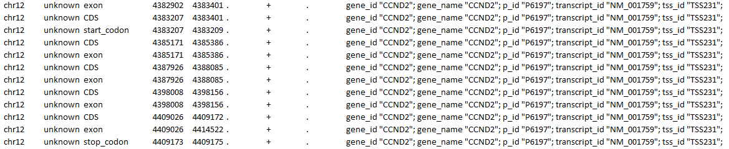
GFF/GTF files
The GFF (General Feature Format) format consists of one line per feature, each containing 9 columns of data (fields).
The GTF (General Transfer Format) is identical to GFF version 2.
Fields must be tab-separated and all fields must contain a value; “empty” fields should be denoted with a ‘.’.
The left columns list source, feature type, and genomic coordinates
The right column includes attributes, including gene ID, etc.

Slide 23
Fields in the GTF files
Sequence Name (i.e., chromosome, scaffold, etc.) Source (program that generated the gtf file or feature) Feature (i.e., gene, exon, CDS, start codon, stop codon) Start (starting location on sequence)
End (end position on sequence)
Score
Strand (+ or -)
Frame (0, 1, or 2: which is first base in codon, zero-based)
Attribute (“;”-delimited list of tags with additional info) This attribute provides info to HISAT2/StringTie
chr12 unknown CDS 3677872
3678014
.
+
2
gene_id "PRMT8"; gene_name "PRMT8"; p_id "P10933"; transcript_id "NM_019854"; tss_id "TSS4368";

Slide 25
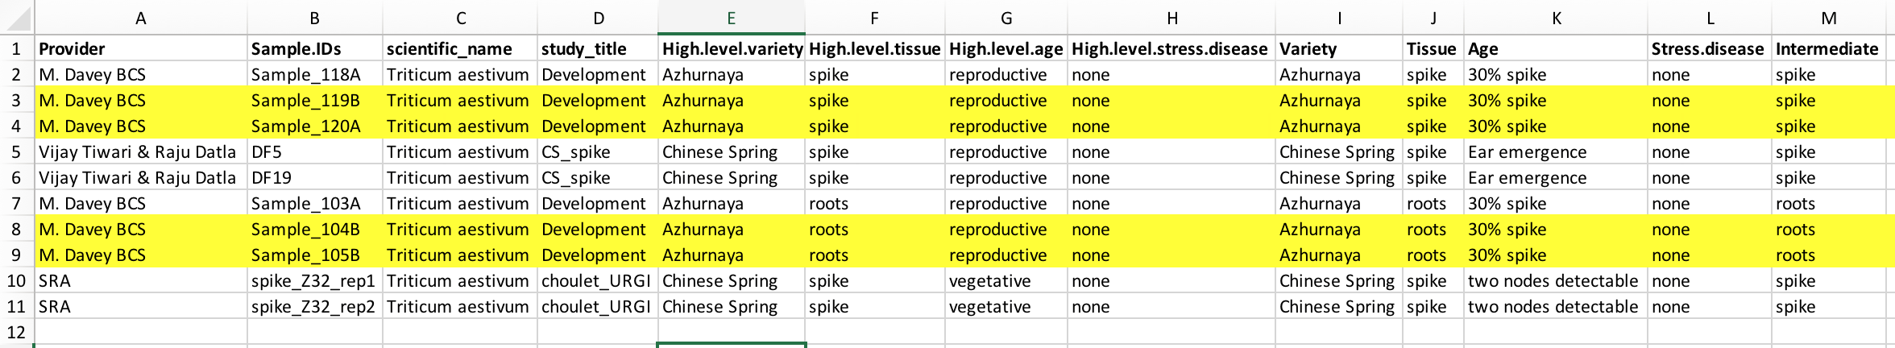
Exploring the dataset
4 wheat mRNA-seq libraries:
2 replicates: 119B, 120A: spike (var. Azhurnaya)
2 replicates: 104B, 105B: root (var. Azhurnaya)
References:
Transcriptome: selected_refseq1.0.fasta
Genome: transformed_coordinates.fasta
GFF: transformed_coordinates.gff
Analyse differential expression between spike and root tissue using two methods (genome and transcriptome alignment).

Slide 26
Transcriptomics:
RNA-seq analysis: Mapping & quantifying reads
Ricardo Ramirez-Gonzalez (JIC)
Rachel Rusholme pilcher, PAUL BAILEY

Slide 27
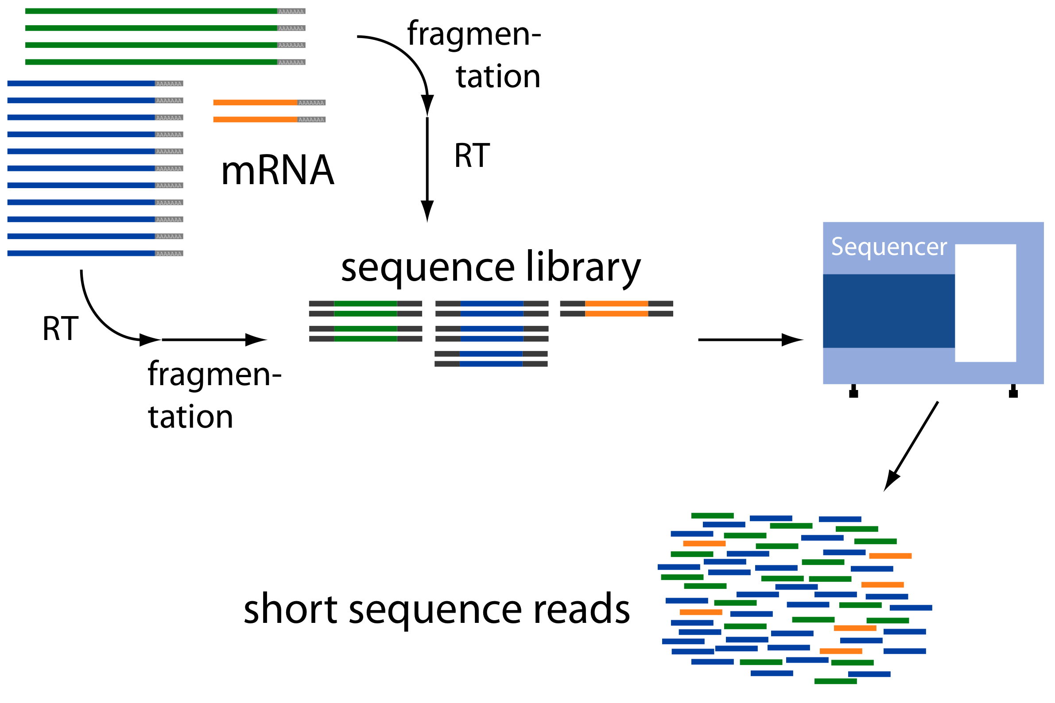
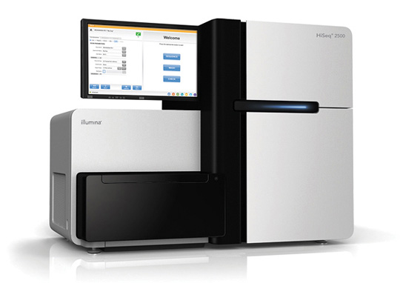
RNA-seq challenge: Transcript Reconstruction
(Avg. ~ 300 b)
Reconstruct original full-length transcripts
(~ 75 to 150 b reads, SE or PE)
Adapted from: http://www2.fml.tuebingen.mpg.de/raetsch/members/research/transcriptomics.html
Notes:
In any case, the transcriptome reads that are generated from sequencing are often much shorter than the original transcript molecules they were derived from, and one of the key bioinformatic challenges is to reconstruct the original full length transcript from the shorter sequencing reads.

Slide 28
RNA-Seq

Slide 29
RNA-Seq Alignment
Splicing Junction!
Mapping RNA-seq reads against a genomic reference needs to account for introns
Introns can range from 50-100,000 bp leaving large gaps in an alignment

Slide 30
RNA-Seq Alignment
Reads across splicing junction misalign!

Slide 31
RNA-Seq Alignment
Bowtie and Tophat fix the alignment

Slide 32
Genome vs. Transcriptome
May seem intuitive to map RNA-seq data to transcriptome, so as not to worry about splice junctions, but often the transcriptome is not complete.
How do we know which transcript of a gene to map to?
If we mapped to all splice variants these would show up as ‘multi-mappers’.
Often a mapper will to its hardest to map every read somewhere, provided the result meets its minimum requirements.

Slide 33
Genome vs. Transcriptome
HISAT2
kallisto
Conesa, A. et al. A survey of best practices for RNA-seq data analysis. Genome Biol. 17, 13 (2016).

Slide 34
Mapping reads to the genome/transcriptome
Requirements:
A reference genome sequence (fasta), or a reference transcriptome (fasta)
The reference genome/transcriptome is pre-processed by indexing, making mapping faster.
Mapping is guided by a genome annotation file (GFF3 or GTF).
The trimmed/cleaned (pre-processed) reads (fastq)

Slide 35
Mapping reads to the genome

Slide 36
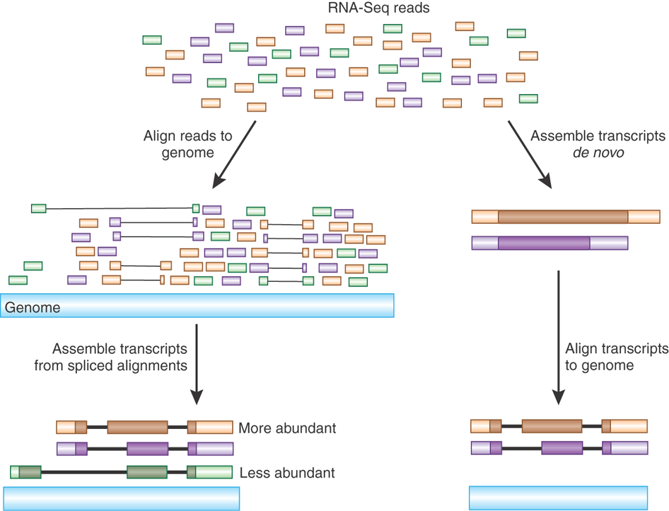
Transcript Reconstruction from RNA-Seq Reads
HISAT2: Hierarchical indexing for spliced alignment of transcripts
Notes:
One strategy requires having a reference genome and involves first aligning reads to the genome using a spliced aligner.

Slide 37
Transcript Reconstruction from RNA-Seq Reads
HISAT2
StringTie
Notes:
Then, the alignments, instead of the original reads, are assembled into transcript structures.

Slide 38
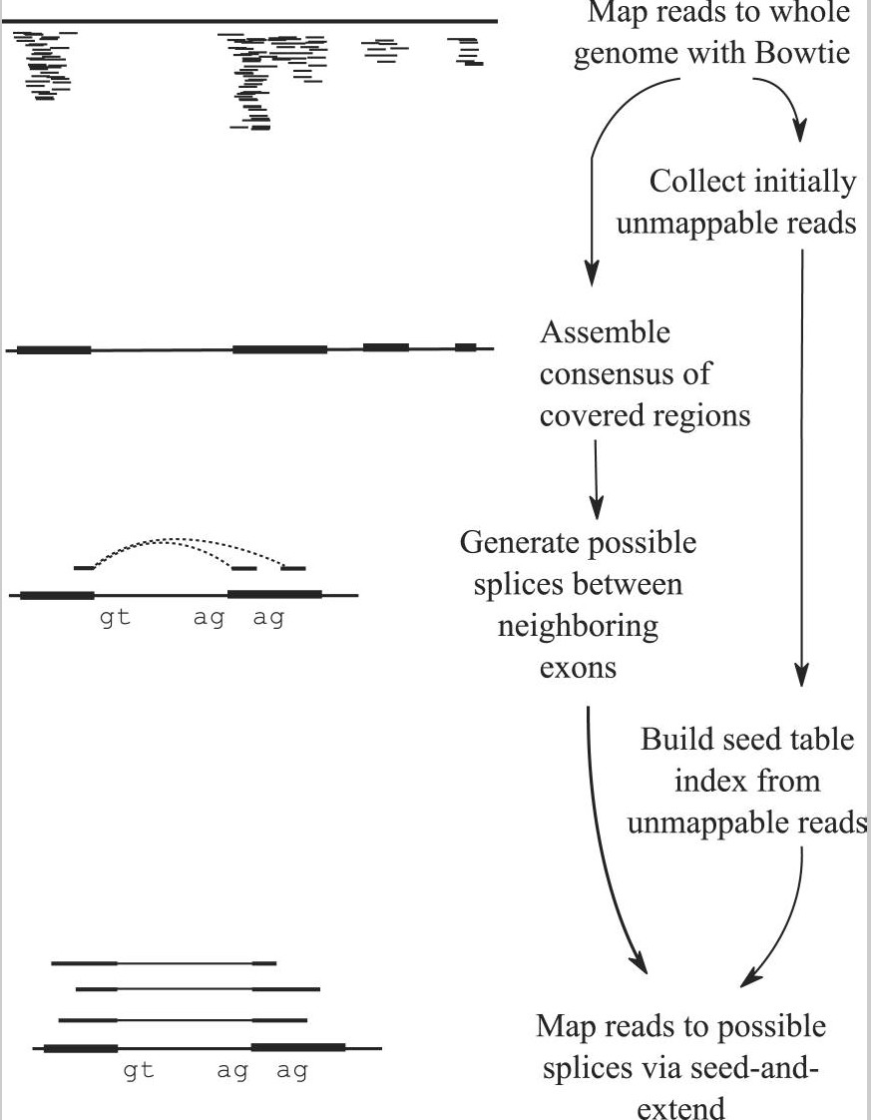
HISAT2 approach to alignment of reads
Output: SAM/BAM file
Kim, D., Langmead, B. & Salzberg, S. L. HISAT: a fast spliced aligner with low memory requirements. Nat. Methods 12, 357–360 (2015).

Slide 39
Mapping reads to the transcriptome

Slide 40
Pseudo-aligners (kallisto)
Quasi-mapping
Probabilistic
Map to transcripts, not genome
Does transcript quantifications (or gene)
FAST and can run on most laptops
Reports suggest differences between ‘traditional’ mappers are in the low abundance genes.
Bray, N. L., Pimentel, H., Melsted, P. & Pachter, L. Near-optimal probabilistic RNA-seq quantification. Nat. Biotechnol. 34, 525–527 (2016).

Slide 41
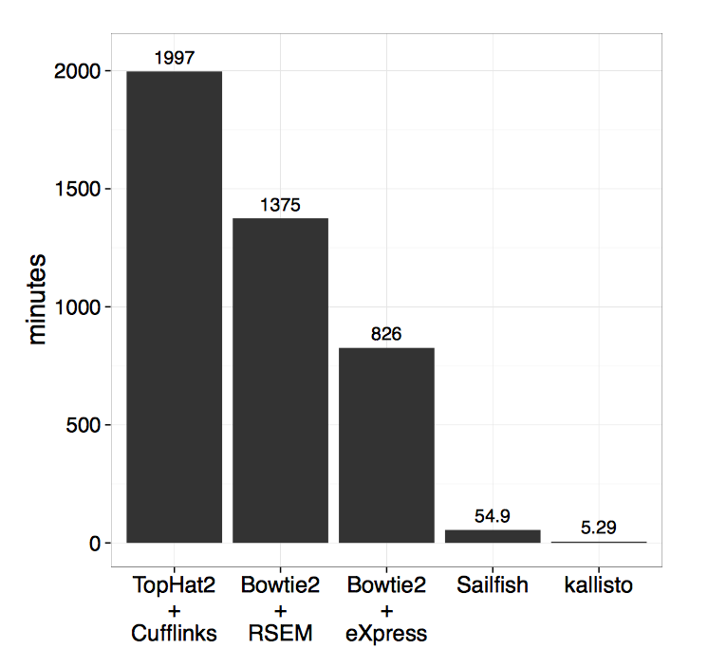
kallisto
Bray, N. L., Pimentel, H., Melsted, P. & Pachter, L. Near-optimal probabilistic RNA-seq quantification.
Nat. Biotechnol. 34, 525–527 (2016).

Slide 42
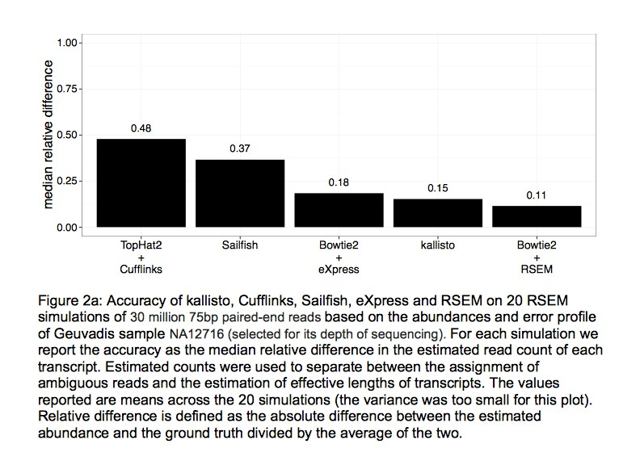
kallisto
Bray, N. L., Pimentel, H., Melsted, P. & Pachter, L. Near-optimal probabilistic RNA-seq quantification.
Nat. Biotechnol. 34, 525–527 (2016).

Slide 43
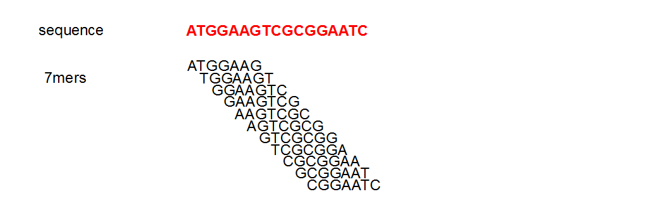
Pseudoalignment evaluates kmers (short segments) of a read

Slide 44
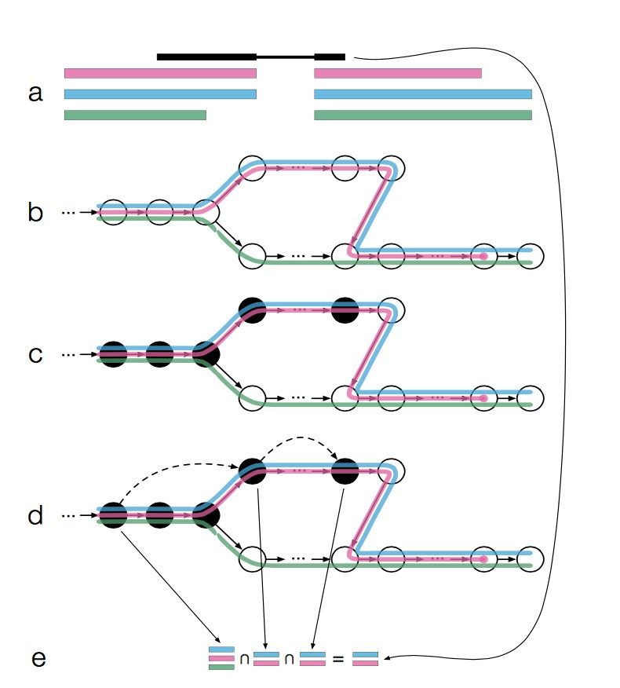
Which transcripts are the read k-mers compatible with?
read
transcripts
•
Construct a de-Bruijn graph from the transcriptome (t- DBG)
•
Evaluate k-mers of reads for compatibility with the t-DBG; can skip over k-mers where compatibility doesn’t change
Bray, N. L., Pimentel, H., Melsted, P. & Pachter, L. Near-optimal probabilistic RNA-seq quantification.
Nat. Biotechnol. 34, 525–527 (2016).

Slide 45
Transcript read counts
Two main sources of bias
Influence of length: Counts are proportional to the
transcript length times the mRNA expression level.
Influence of sequencing depth: The higher sequencing depth, the higher counts.
How to deal with this
Normalize (correct) gene counts to minimize biases.
Use statistical models that take into account
length and sequencing depth
10 ye

Slide 46
Within sample normalization
Transcript-mapped read counts are normalized for both length of the transcript and total depth of sequencing.
Reported as:
HISAT2: Number of RNA-Seq Fragments Per Kilobase of transcript
per total Million fragments mapped: FPKM (PE), or RPKM (reads per kb per M) (SE)
kallisto: Transcripts Per Million
These methods allow for comparison of features with different length WITHIN a sample but not BETWEEN samples.
Notes:
And so, when computing expression for transcripts, both the number of reads mapping to each transcript and the lengths of those transcripts must be taken into account.
The metric reported is often in units of FPKM.

Slide 47
kallisto uses TPM
RPKM/FPKM is not comparable between experiments owing to differences in mean expressed transcript length
TPM is normalized for mean expressed transcript length and therefore is more useful for comparing relative expression levels between samples
Preferred metric for measuring expression
Better reflects transcript concentration in the sample.
Nicely sums to 1 million
Linear relationship between TPM and FPKM values
Both are valid metrics, but best to be consistent
TPM
FPKM

Slide 48
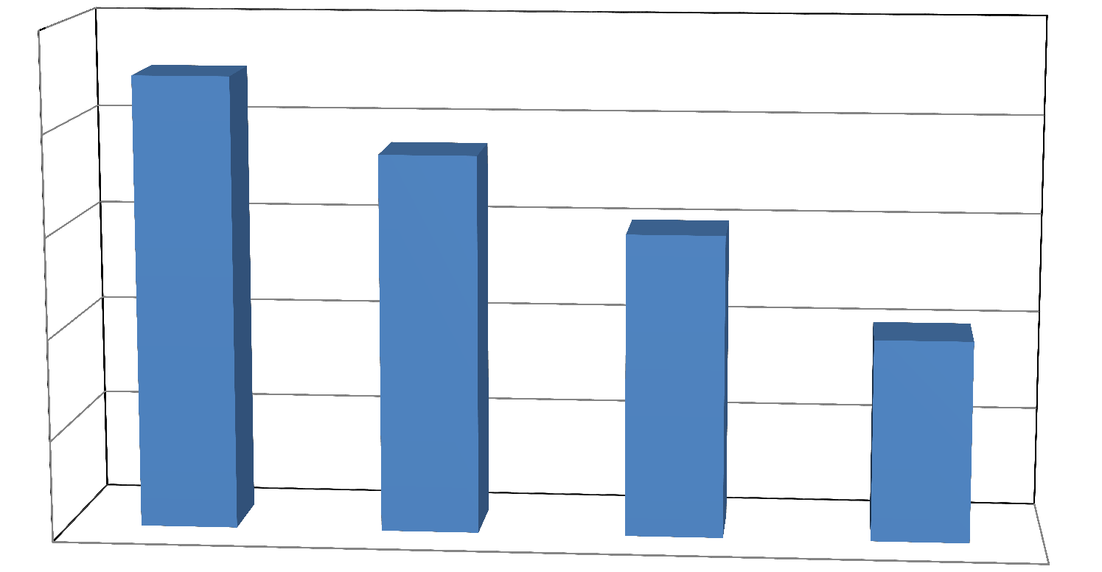
How well do the reads align to reference?
100
80
60
40
20
0
% Reads Mapped
Great!
Good
Incomplete Reference?
Sample Contamination?
Reads mis-paired?

Slide 49


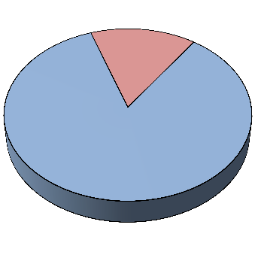
Assessing read quality
rRNA contamination
mRNA
rRNA
rRNA
rRNA
mRNA
mRNA
Total RNA sample
After PolyA isolation
After rRNA depletion
Align reads to rRNA sequences from organism or relatives
Generally, don’t need to remove rRNA reads

Slide 50
Multi-mapping reads
Some reads will align to more than one place in the reference, because:
Common domains, duplication, gene families
Paralogs, pseudogenes, etc.
Shared exons (if reference is transcriptome)
This can distort counts, leading to misleading expression levels
If a read can’t be uniquely mapped, how should it be counted?
Should it be ignored (not counted at all)?
Should it be randomly assigned to one location among all the locations to which it aligns equally well?
This may depend on the question you’re asking……and also depends on the software you use.

Slide 52
Mapping and quantifying the reads

Slide 53
Transcriptomics:
RNA-seq analysis: Normalization and DE
Ricardo Ramirez-Gonzalez (JIC)
Rachel Rusholme pilcher, PAUL BAILEY

Slide 54
Differential expression analysis
Differential expression analysis means taking the normalized sequencing fragment count data and performing statistical analysis to discover quantitative changes in gene expression levels between experimental groups.
For example, we use statistical testing to decide whether, for a given gene, an overserved difference in fragment counts between groups is significant, that is, whether it is greater than what would be expected just do to random biological variation.

Slide 55
Filtering reads
Most common filter is to remove genes that are less than x normalized read counts across a certain number of samples.
A second less used filter is for genes with minimum variance across all samples, so if a gene isn’t changing (constant expression) its inherently not interesting, therefore no need to test.

Slide 56
Statistical models for count data
The number of reads that are mapped into a gene was first modelled using a Poisson distribution.
Poisson distribution appears when things are counted.
It assumes that mean and variance are the same.
However biological variability of RNA-seq count data cannot be captured using the Poisson distribution because data present overdispersion (ie. variance of counts larger than mean)
Negative Binomial (NB) distribution takes into account overdispersion; hence, it has been used to model RNA-seq data
Poisson distribution has only one parameter λ, while NB is a two-parameter distribution λ and φ.

Slide 57
Statistical models for count data
Different packages use different statistical models, based on known probability distributions such as Binomial, Poisson, Negative Binomial, etc.
R packages in Bioconductor:
edgeR (Robinson et al., 2010): Exact test based on Negative Binomial distribution.
DESeq (Anders and Huber, 2010): Exact test based on Negative Binomial distribution.
DEGseq (Wang et al., 2010): MA-plots based methods (MATR and MARS), assuming Normal distribution for M|A.
baySeq (Hardcastle et al., 2010): Estimation of the posterior likelihood of differential expression (or more complex hypotheses) via empirical Bayesian methods using Poisson or NB distributions.

Slide 58
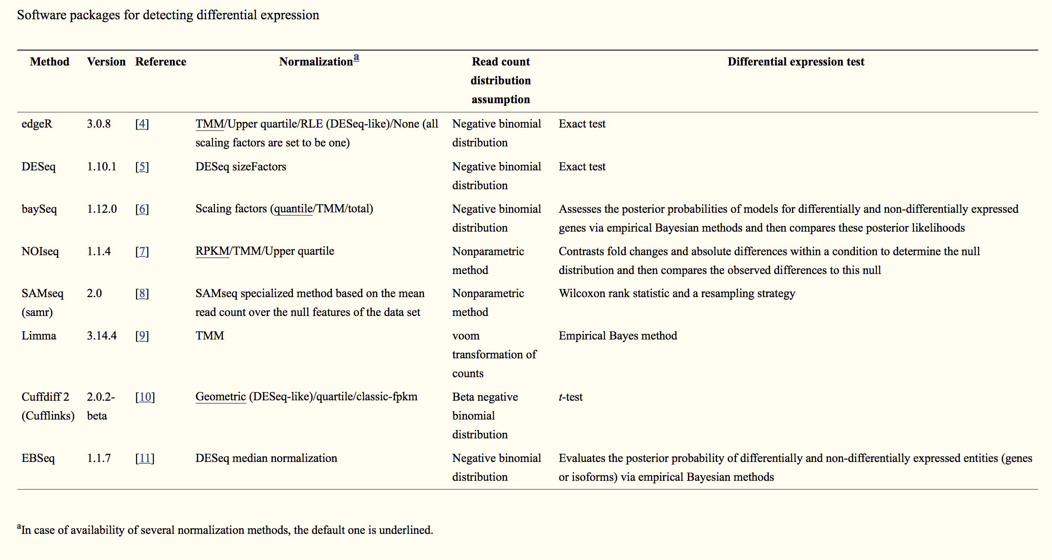
Differential expression analysis tools compared……
Seyednasrollah, F., Laiho, A. & Elo, L. L. Comparison of software packages for detecting differential expression in RNA-seq studies. Brief. Bioinform. 16, 59–70 (2013).

Slide 59
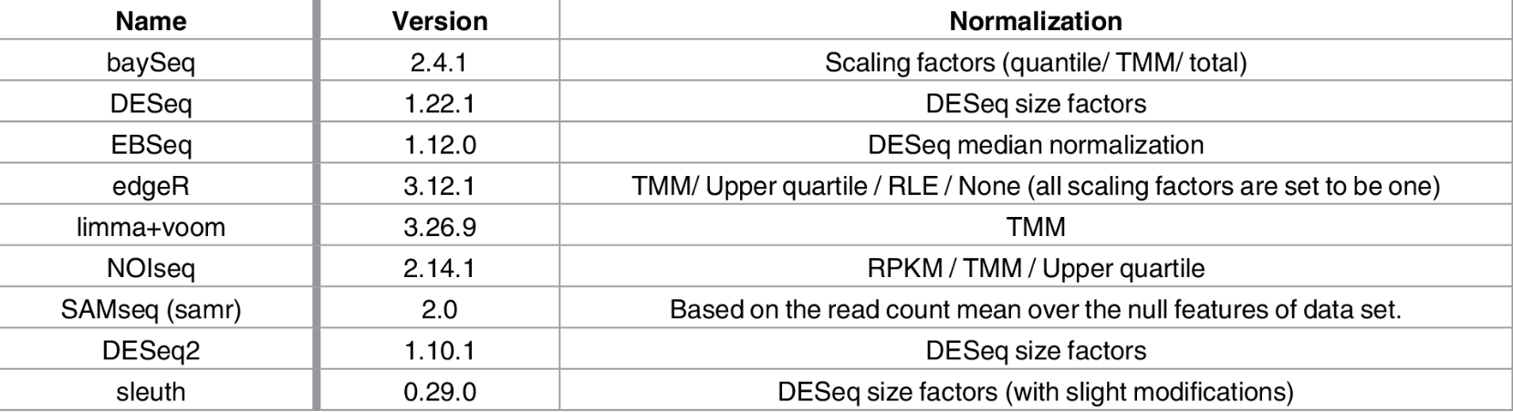
More comparisons……
Costa-Silva, J., Domingues, D. & Lopes, F. M. RNA-Seq differential expression analysis: An extended review and a software tool. PLoS One 12, 1–18 (2017).

Slide 60
Typical output from DE analysis
logFC logCPM p-value FDR
TRINITY_DN876_c0_g1_i1 -7.15049572793027 10.6197708379285 0 0
TRINITY_DN6470_c0_g1_i1 -7.26777912190146 7.03987604865422 1.687485656951e-287 6.46813252309319e-284
TRINITY_DN5186_c0_g1_i1 -7.85623682454322 9.18570464327063 1.17049180235068e-278 2.99099671894011e-275
TRINITY_DN768_c0_g1_i1 7.72884741150304 9.7514619195169 4.32504881419265e-272 8.28895605240022e-269
TRINITY_DN70_c0_g1_i1 -12.7646078189688 7.86482982471445 3.92853491279431e-253 6.02322972829624e-250
TRINITY_DN1587_c0_g1_i1 -5.89392061881667 9.07366563894607 6.32919557933429e-243 8.08660221852944e-240
TRINITY_DN3236_c0_g1_i1 -7.27029815068473 8.02209568234202 3.64955175271959e-235 3.99678053376405e-232
TRINITY_DN4631_c0_g1_i1 -7.45310693639574 6.91664918183241 4.30540921272851e-229 4.1256583780971e-226
TRINITY_DN5082_c0_g5_i1 -5.33154406167545 10.6977538760467 2.74243356676259e-225 2.33594396920022e-222
TRINITY_DN1789_c0_g3_i1 10.2032564835076 7.32607652700285 1.44273728647186e-213 1.10600240380933e-210
TRINITY_DN4204_c0_g1_i1 4.81030233739325 9.88844409410644 9.27180216086162e-205 6.46160321501501e-202
TRINITY_DN799_c0_g1_i1 -4.22044475626154 6.9937398638711 1.24746518421083e-197 7.96922341846683e-195
TRINITY_DN196_c0_g2_i1 4.60597918494257 9.86878463857276 1.9819997623131e-192 1.16877001368402e-189
TRINITY_DN5041_c0_g1_i1 -4.27126549355785 9.70894399883 1.8930437900069e-185 1.03657669244235e-182
TRINITY_DN1619_c0_g1_i1 -4.47156415953777 9.22535948721718 1.76766063029526e-181 9.03392426122899e-179
TRINITY_DN899_c0_g1_i1 -4.90914328409143 7.93768691394594 1.11054513767547e-180 5.32089939088761e-178
TRINITY_DN324_c0_g2_i1 4.87160837667488 6.84850312231775 2.20092562166991e-179 9.92487989160089e-177
TRINITY_DN3241_c0_g1_i1 -4.77760618069256 7.94111259715689 1.60585457735621e-173 6.83915621667372e-171
TRINITY_DN4379_c0_g1_i1 3.85133572453294 7.23712813663389 3.48140532848425e-164 1.4046554341137e-161
TRINITY_DN1919_c0_g1_i1 4.05998814332136 6.95937301668582 1.8588621194715e-161 7.12501850393425e-159
TRINITY_DN2504_c0_g1_i1 -6.92417817059644 6.20370039359785 2.42022459856956e-160 8.83497227268296e-158
…
Up vs. Down regulated
Avg. expression level
Significance

Slide 61
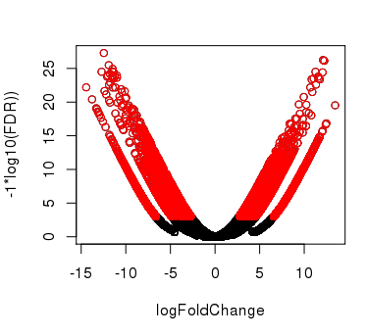
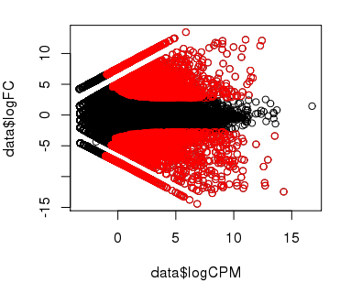
Plotting Pairwise Differential Expression Data
Volcano plot
( fold change vs. significance)
MA plot
(abundance vs. fold change)
Log₁₀ (FDR)
Log₂ (fold change) (M of MA)
Log₂ (fold change)
Log₂ Average Expression level (A of MA)
Significantly differently expressed transcripts have FDR <= 0.001
(shown in red)

Slide 62
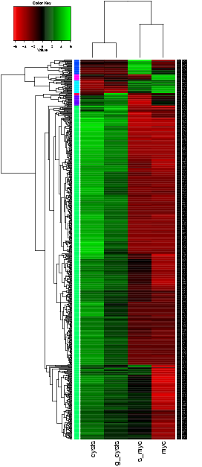
Comparing Multiple Samples
Heatmaps provide an effective tool for navigating differential expression across multiple samples.
Clustering can be performed across both axes:
-cluster transcripts with similar expression patters.
-cluster samples according to similar expression values among transcripts.

Slide 64
Analysis of differential expression

Slide 65
Transcriptomics:
RNA-seq analysis: Summary
Ricardo Ramirez-Gonzalez (JIC)
Rachel Rusholme pilcher, PAUL BAILEY

Slide 66
Summary of Key Points
RNA-Seq is a versatile method for transcriptome analysis enabling quantification and novel transcript discovery.
Reads can be mapped to either the genome (splice-aware aligner) or transcriptome.
Expression quantification is based on sampling and counting reads derived from transcripts
Samples are normalized both within (FPKM/TPM) and between samples (TMM, upper quartile, quantile, bootstrapping etc.)
DE calls are based on fitting normalized counts to statistical models
DE analysis yields lists of differentially expressed genes with associated FC and p-value/q-values

Slide 67
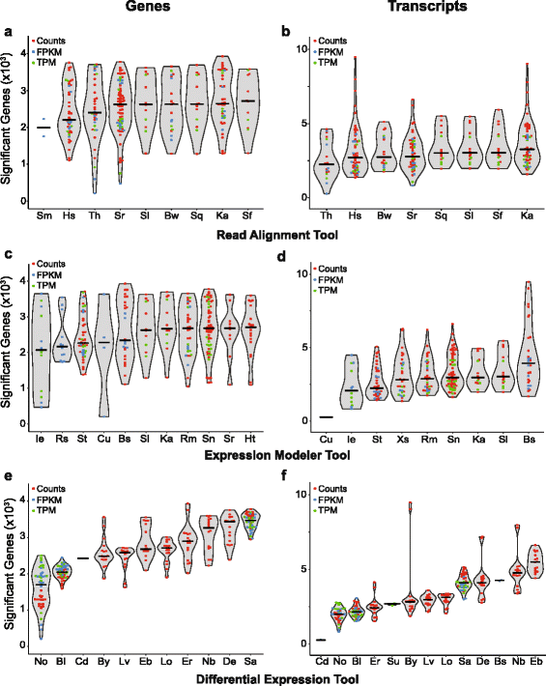
Workflow Comparisons
Williams et al. Empirical assessment of analysis workflows for differential expression analysis of human samples using RNA-Seq. 2017. BMC Bioinformatics 18:38

Slide 68
Going Beyond Gene Lists
Additional analysis:
GO (gene ontology) terms
Identifying co-expressed genes and network inference
Results of RNA-seq data can be integrated with other sources of biological data to establish a more complete picture of gene regulation. Such as:
Genotyping data identify genetic loci responsible for variation in gene expression between individuals
Epigenomic information (transcription factor binding, histone modification, methylation)

